Slide 1
Academic, Scientific and Managerial Personnel Needed to Support the Emerging Gas and Oil Industry in Sri Lanka
Prof. Ranjith Senaratne
Vice Chairman, University Grants Commission and
Chairman, Ocean University of Sri Lanka
and
Emeritus Prof. Kapila Dahanayake
Department of Geology, University of Peradeniya

Slide 2
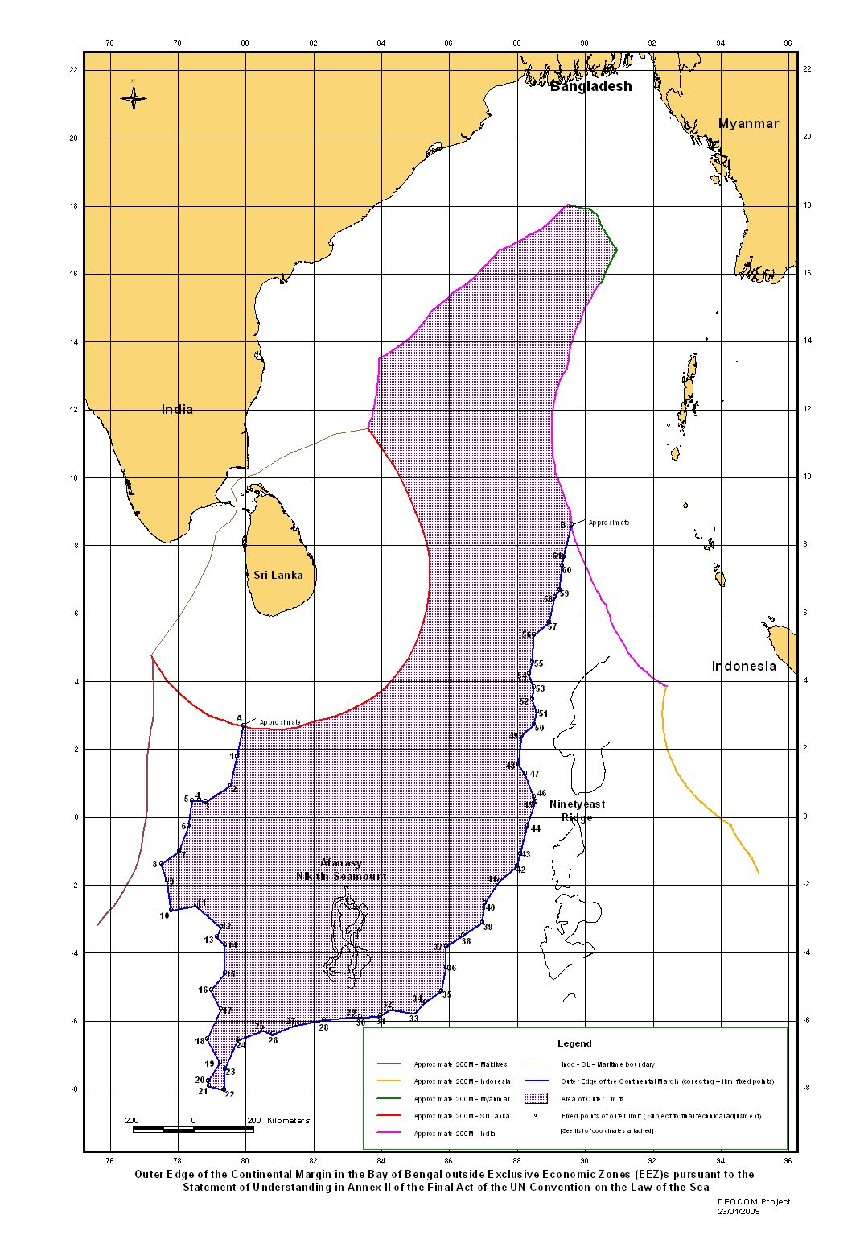
Our ocean
resources
S L c. 65,000 km²
EEZ x 8 of Land mass
Approx. 517,000 km²
x8
x23
X 8
Claimed EEZ x 23 of Land mass
Approx. 1,400,000 km²

Slide 3
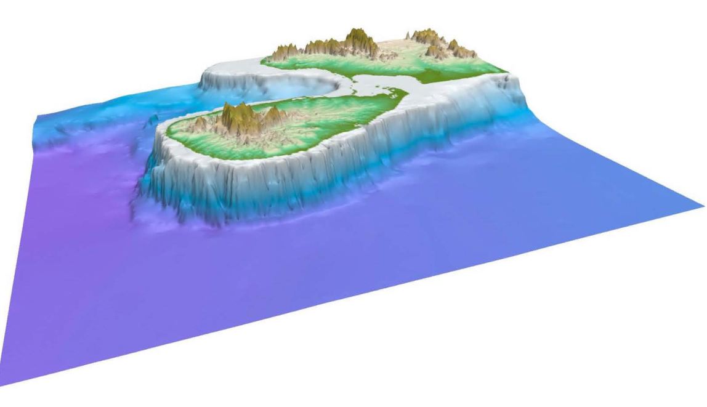
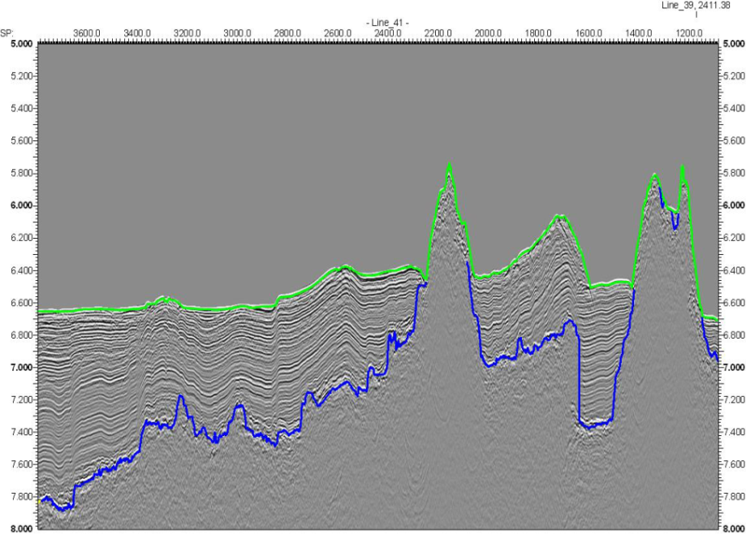
Mineral Deposits
Deposits with
valuable minerals
Continental Reef
A nodule of hydrate

Slide 4
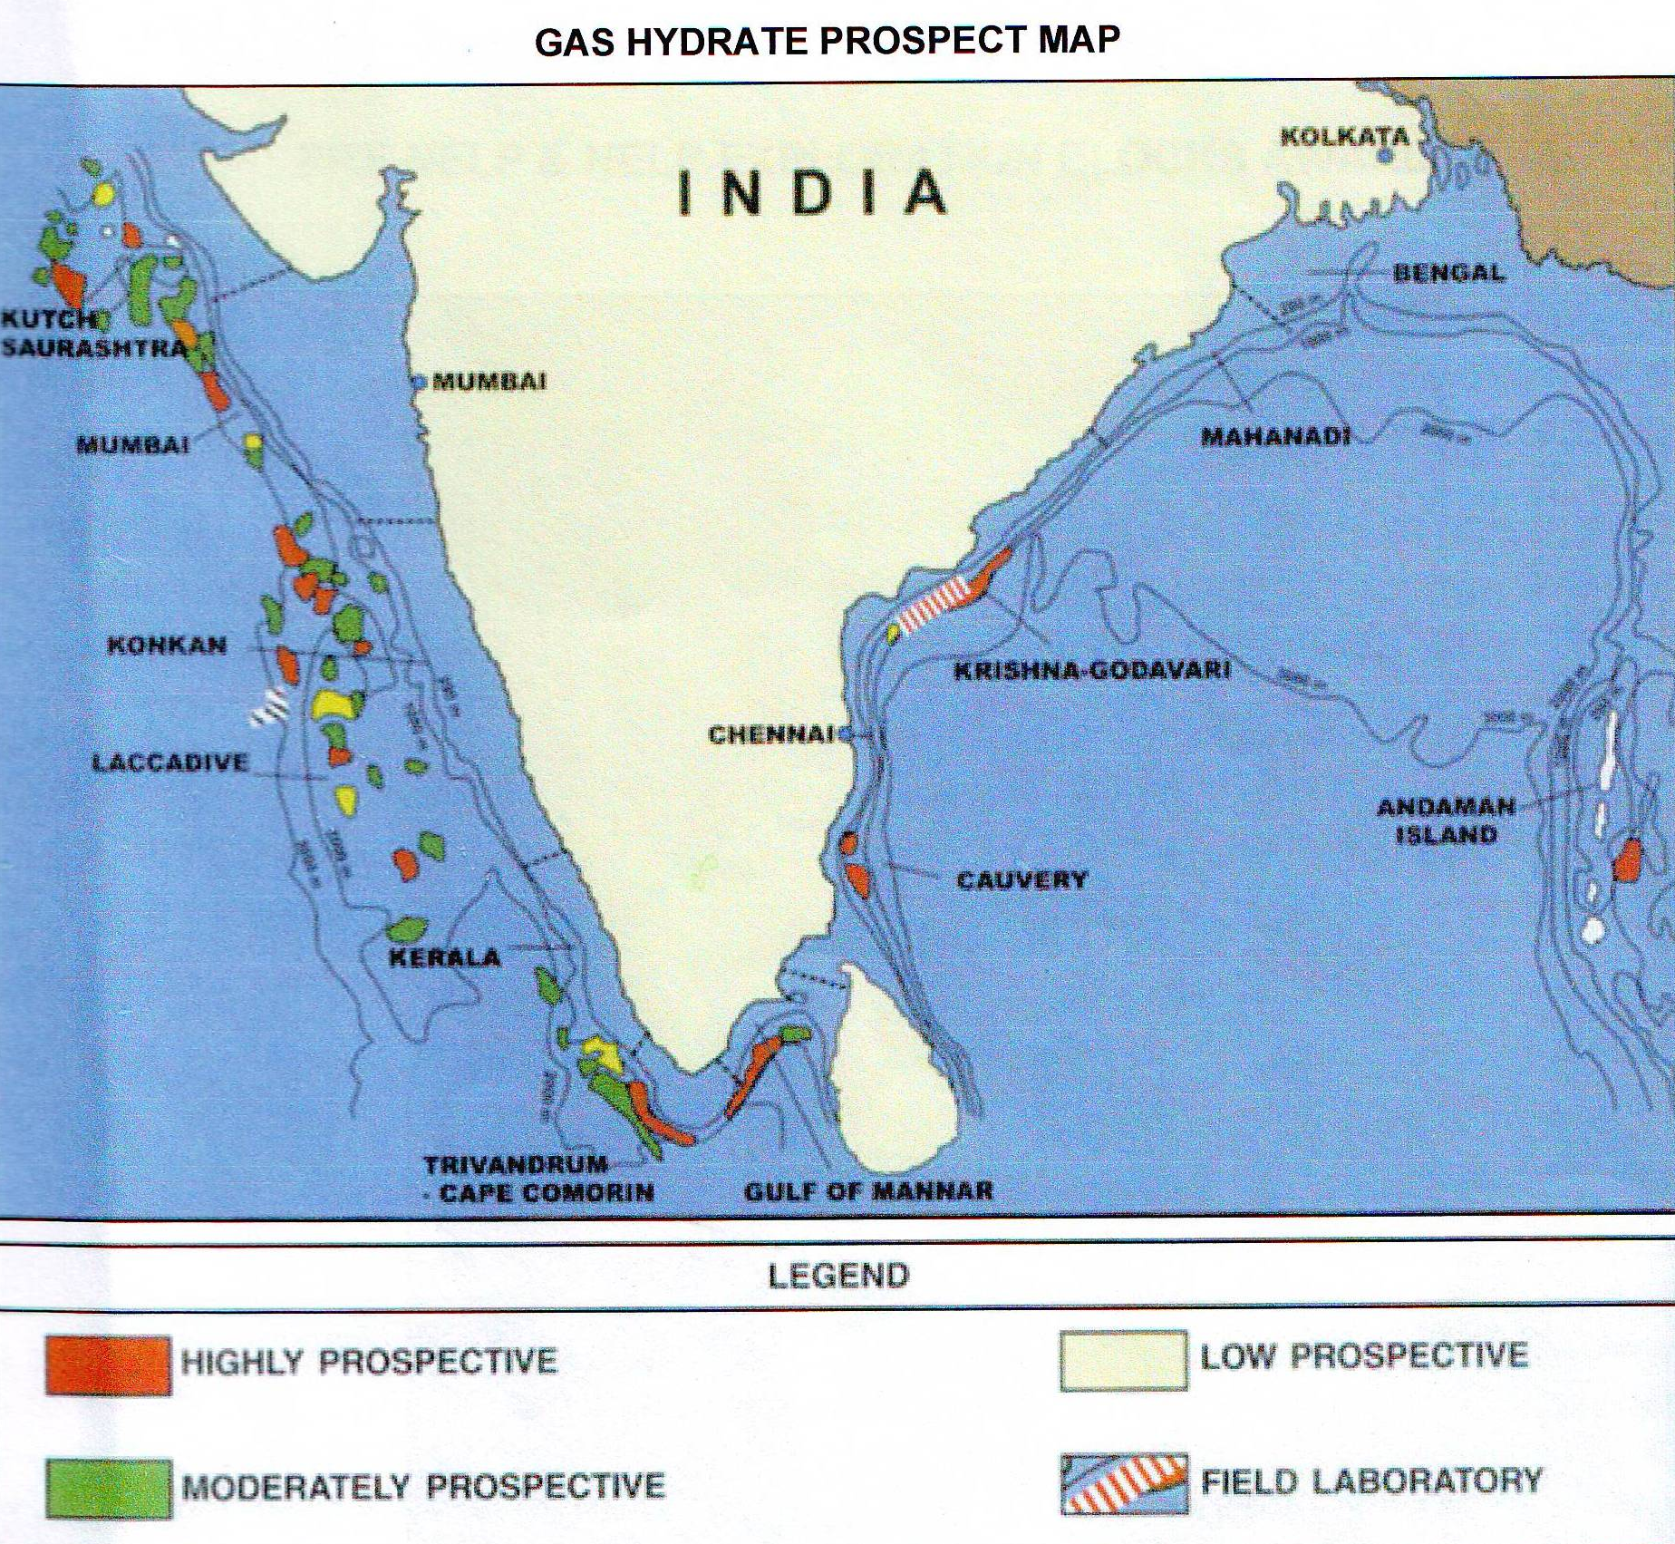
Hydrocarbon map

Slide 5
HEIs in Sri Lanka
Under the purview of the UGC
15 Universities
10 degree awarding institutes
7 postgraduate institutes
Degrees not related to Oceanic Sciences
Degrees related to Oceanic resources incl. maritime field

Slide 6
Marine Resources Degree Programmes
a. Biological
Universities of Ruhuna
Fisheries & Marine Science
Wayamba University of Sri Lanka
Food Production & Technology Management (Field of Specialization: Aquaculture & Fisheries)
b. Chemical/Physical
University of Peradeniya
Geology
University of Moratuwa (Department of Earth Resources Engineering )
Mining and Mineral Engineering
Earth Resources Engineering

Slide 7
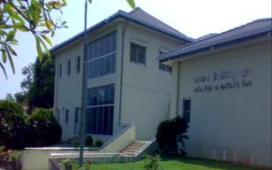
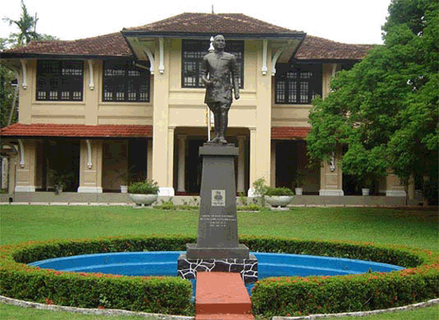
Outside the purview of the UGC
National Institute of Fisheries and Nautical Engineering (Ocean Univ.)
Marine Engineering
Fisheries and Marine Science
Kotalawela Defense University
Marine Engineering
CINEC Maritime Campus
B Sc Marine Engineering
B Sc Maritime Science
B Eng Marine and Offshore Systems Engineering
B Eng Marine and Offshore Systems Engineering

Slide 8
Major segments in Petroleum Industry
Upstream - Exploration & production of gas/oil
Midstream - Refining and processing
Downstream - Distribution and Marketing

Slide 9
Fields relevant to Gas and Oil Industry
Oceanography
Petroleum Sciences
Marine Geology
Geophysics
Geochemistry
Hydrology
Mud Logging
Maritime Health, Safety, Security and Environment (HSSE)
Off-shore Surveying and Digital Mapping
Off-shore Engineering
Engineering Geology
Petroleum Engineering
Sedimentary petrology

Slide 10
Process Engineering
Chemical Engineering
Drilling Engineering
Mining Engineering
Reservoir Engineering
Pipeline Design Engineering
Structural Engineering
Sub-sea Hardware Engineering
Naval Architecture
Oil Brokering
Plant Management
Personnel Management
Marketing Management
Account Management
Maritime Transportation and Logistics
Law of the Sea

Slide 11
Degrees offered related to Petroleum Sciences and allied fields
Country | University | Title of degree programme | Special features
Sri Lanka | Kotelawala Defence University | B Sc in Marine Engineering
 | University of Moratuwa | B Sc in Mining and Mineral Engineering
 |  | B Sc in Earth Resources Engineering | Minor in Ocean Resources Engineering
 |  | M.Sc. in Mining and Mineral Exploration
 | Ocean University of Sri Lanka | B Sc in Fisheries and Marine Science | General / Special
 |  | B Sc in Marine Engineering/Naval Architecture | General / Special
 | CINEC Maritime Campus | B Sc in Marine Engineering
 |  | B Sc Maritime Science
 |  | B Eng in Marine and Offshore Systems Engineering
 |  | B Eng in Marine and Offshore Systems Engineering
 |  | M Sc in Maritime Safety and Environmental Management
 |  | M Sc in Maritime Engineering
 |  | International Transportation Management And Logistics | Masters & PhDs available

Slide 12
Country | University | Title of degree programme | Special features
China | China University of Petroleum | B Sc in Petroleum Engineering
 |  | Oil and Gas Drilling Engineering | Masters & PhD
 |  | Oil and Gas Developing Engineering
 |  | Petroleum and Gas Well Engineering | Masters
 |  | Oil and Gas Storage and Transportation Engineering | PhD
 |  | Petroleum Engineering Management
Sweden | World Maritime University | Maritime Safety & Environmental Administration | Masters
 |  | Marine Environmental & Ocean Management
United Kingdom | Newcastle University | B Eng. Offshore Engineering | Masters
 |  | B Eng. Marine Engineering & Naval Architecture

Slide 13
Country | University | Title of degree programme | Special features
Scotland | Robert Gordon University | B Eng Mechanical and Offshore Engineering | Masters
Australia | Australian Maritime College | MBA in Maritime and Logistics Management | PhD
India | Indian Maritime University | MBA in International Transportation and Logistics Management
 |  | LLM Maritime Law
Saudi Arabia | King Fahd University of Petroleum & Minerals | B Sc in Geology
Egypt | The American University in Cairo | B.Sc. in Petroleum Engineering
Egypt | Alexandria University | Offshore Engineering
Netherlands | Delft University | B Sc Marine Technology

Slide 14
Constraints
Lack of necessary trained manpower
Lack of relevant courses
Lack of relevant laboratory, workshop and field facilities
Inadequacy of funds for capacity building

Slide 15
Way Forward
Development of a database of human and physical resources available in SL at HEIs, and public & private sector institutions related to PE
Universities (Moratuwa, Peradeniya, etc.)
Public Sector (Sri Lanka Port Authority, Geological Survey and Mines Bureau, Ceylon Petroleum Corporation, PDRS, etc.)
Private Sector (Colombo Dockyard Pvt. Ltd., Lanka Hydraulics Institute, Master Divers, LAUGHS Lanka Pvt. Ltd., CINEC, etc.)
Development of a database of Sri Lankan expatriates with knowledge and experience related to PE and formulation of an attractive package to obtain their services

Slide 16
Rationalization of those resources to identify , develop and conduct necessary training and academic programmes
Identification of training needs incl. postgraduate training
Development of laboratory, workshop and field facilities
Development of curricula for the courses to meet the needs of the E & P and R & M sectors
Development of link programmes with relevant renowned foreign universities, research institutions etc. for capacity building
Formulation of proposals to secure requisite funding for capacity building (HR, PR and curriculum) in selected HEIs
incl. UNESCO

Slide 17
It is proposed to appoint a Committee comprising members from relevant key institutions to attend to the above within a stipulated period of time
UGC
Universities (i.e. Moratuwa, Peradeniya, SJP etc.)
Public Sector (i.e. Ministry of Finance, Ministry of Petroleum Industries, PRDS, CPC, SLPA, GSMB etc.)
Private Sector (CDPL, LHI etc.)

